Slide 1
Capstone Engagement
Assessment, Analysis, and Hardening of a Vulnerable System
By Dean Baberowski

Slide 2
Table of Contents
This document contains the following sections:
01
Network Topology
02
Red Team: Security Assessment
03
Blue Team: Log Analysis and Attack Characterization
Hardening: Proposed Alarms and Mitigation Strategies
04

Slide 3
Network Topology
‹#›

Slide 4
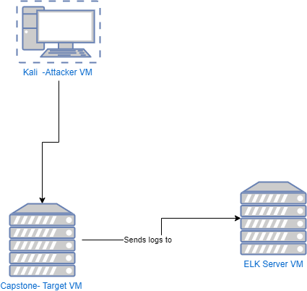
Network Topology
Network
Address Range: 192.168.1.0/24
Netmask: 255.255.255.0
Gateway: 192.168.1.1
Machines
IPv4: 192.168.1.90
OS: Linux
Hostname: Kali
IPv4: 192.168.1.100
OS: Linux
Hostname: ELK
IPv4: 192.168.1.105
OS: Linux
Hostname: Capstone

Slide 5

Red Team
Security Assessment
‹#›

Slide 6
Recon: Describing the Target
Nmap identified the following hosts on the network:
Hostname | IP Address | Role on Network
Capstone Server | 192.168.1.105 | Web Server
ELK | 192.168.1.100 | ELK Stack Server
Kali Machine | 192.168.1.90 | Attacking Machine

Slide 7
Vulnerability Assessment
The assessment uncovered the following critical vulnerabilities in the target:
Vulnerability | Description | Impact
Use the CVE number if it exists. Otherwise, use the common name. | Describe the vulnerability. | Describe what this vulnerability allows the attacker to do.
Sensitive Data Exposure | The secret_folder is publicly accessible, and contains information for authorised personnel. | The exposure compromises credentials that an attacker can break into the web server
Unauthorised File Upload | Users are allowed to upload any file to the web server | This vulnerability allows users to upload PHP scripts to the server.
Brute Force Vulnerability Critical | Allows an attacker to guess to passwords using brute force on a system. | Allows attacker access to the system.

Slide 8
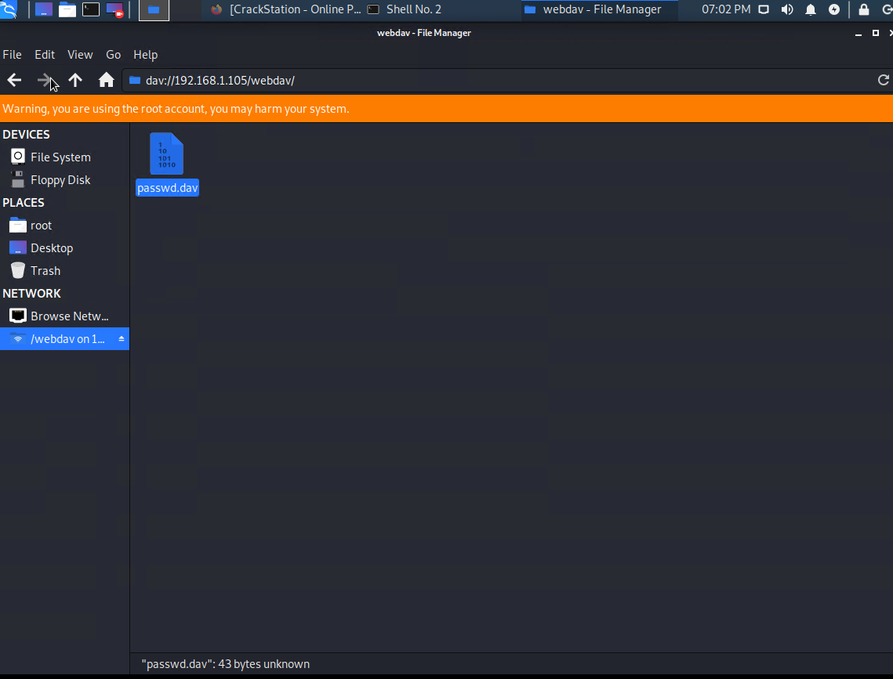
Exploitation: Sensitive Data Exposure
01
02
03
Tools & Processes
Used nmap to scan network
Achievements
Gained access to the web server by typing in the ip address of the server
[INSERT: screenshot or command output illustrating the exploit.]

Slide 9
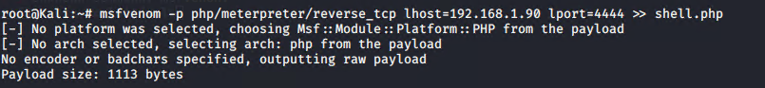
Exploitation: Unauthorised File Upload
01
02
03
Tools & Processes
How did you exploit the vulnerability? Which tool (Nmap, etc.) or techniques (XSS, etc.) did you use?
Used msfvenon to e
Achievements
What did the exploit achieve? For example: Did it grant you a user shell, root access, etc.?
Uploaded a payload to the server and gained access to it

Slide 10
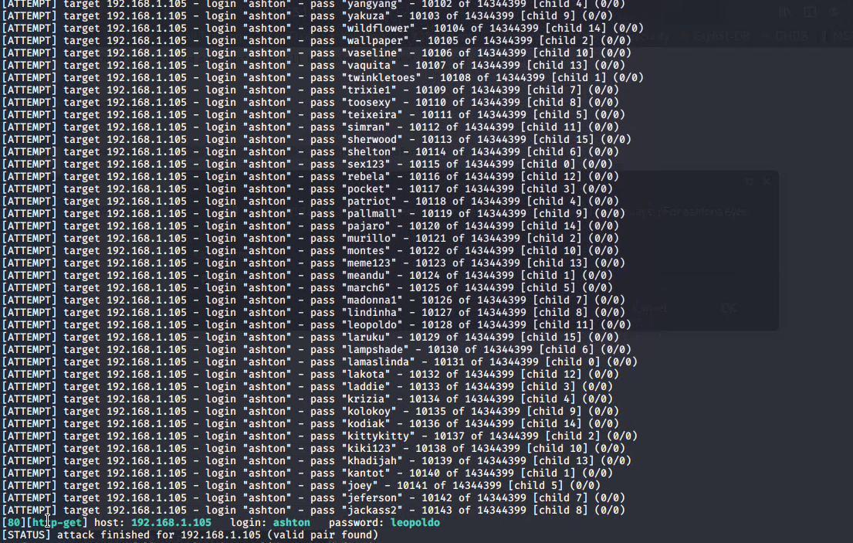
Exploitation: Brute Force Attack Vulnerability
01
02
03
Tools & Processes
Using the hydra command I was able to brute force the password a user's account
Achievements
Granted access the user account for the secret folder located on the web server
[INSERT: screenshot or command output illustrating the exploit.]

Slide 11

Blue Team
Log Analysis and Attack Characterization
‹#›

Slide 12

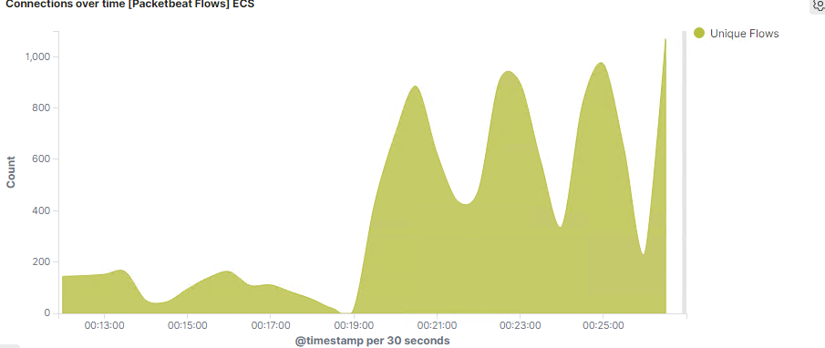
Analysis: Identifying the Port Scan
Answer the following questions in bullet points under the screenshot if space allows. Otherwise, add the answers to speaker notes.
What time did the port scan occur? 7pm
How many packets were sent, and from which IP?
What indicates that this was a port scan? The amount of requests made
[Insert Here]
Include a screenshot of Kibana logs depicting the port scan.
Notes:
The graph in the dashboard of Kibana shows a sudden increase in the unique flow of data between the Kali machine and the Capstone machine. This indicates the port scan has taken place.

Slide 13
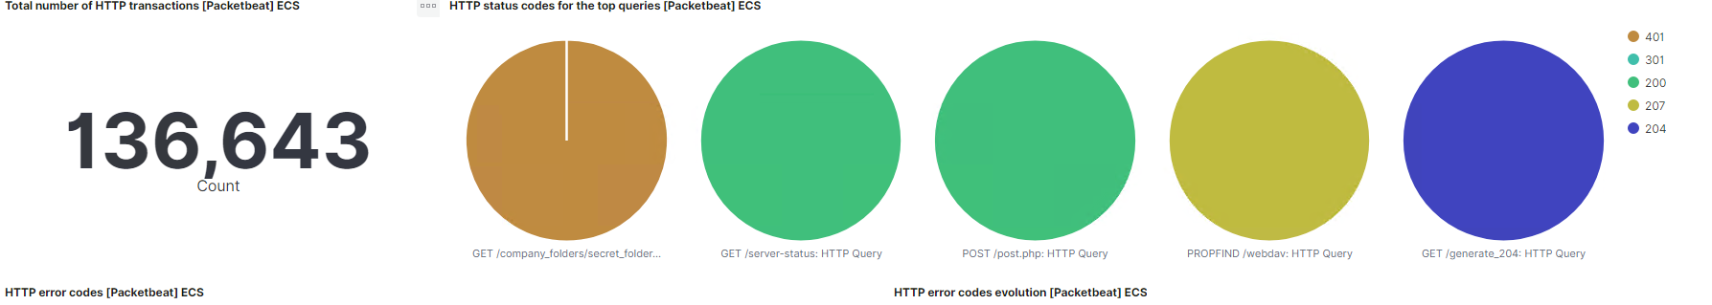
Analysis: Finding the Request for the Hidden Directory
Answer the following questions in bullet points under the screenshot if space allows. Otherwise, add the answers to speaker notes.
What time did the request occur? How many requests were made?
Which files were requested? What did they contain?
[Insert Here]
Include a screenshot of Kibana logs depicting the request for the hidden directory.
Notes:
The first request started at 2:45pm and ended at 7pm the next day.There were 136,643 requests made in total but 9,568 requests were made on at the time of the attack.
The main file that was requested was the company_folder and secret_folder which is where the secret password file was accessed.
Webdav was also accessed.

Slide 14
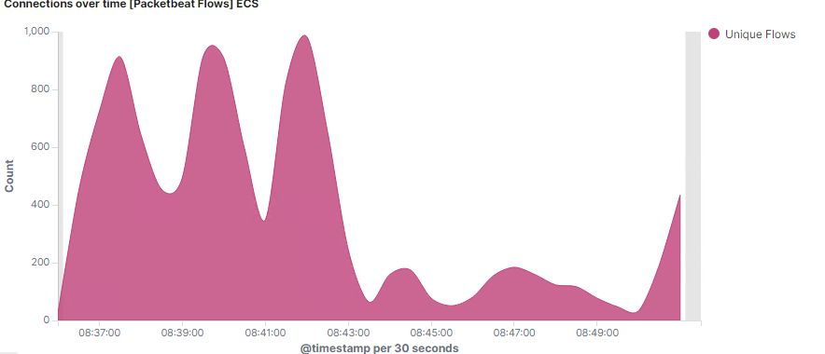
Analysis: Uncovering the Brute Force Attack
[Insert Here]
Include a screenshot of Kibana logs depicting the brute force attack.
This graph shows the peak flow of connections. Only 5 attempts were successful. This is a tailgate
Notes:
The screenshot above shows the peak flow of connections. There were 983 requests made in the attack. Before the attacker discovered the password there less at around 200 requests made

Slide 15
Analysis: Finding the WebDAV Connection
Answer the following questions in bullet points under the screenshot if space allows. Otherwise, add the answers to speaker notes.
How many requests were made to this directory?
Which files were requested?
[Insert Here]
Add a screenshot of Kibana logs depicting the WebDAV connection.
The secret_folder directory was requested 6,961 times
The shell.php file was requested 6 times

Slide 16
Blue Team
Proposed Alarms and Mitigation Strategies
‹#›

Slide 17
Mitigation: Blocking the Port Scan
What kind of alarm can be set to detect future port scans?
The alarms that can be set to detect open ports is the number of requests per Second
What threshold would you set to activate this alarm?
If there are more than 10 requests per a second and more than 5 seconds it would activate the alarm
What configurations can be set on the host to mitigate port scans?
Any ports that are not in use by the system should be blocked by using a firewall setup on the host machine.
Also an IP whitelist can be enabled
Describe the solution. If possible, provide required command lines.
ufw should be configured to block ports that are not in use.

Slide 18
Mitigation: Finding the Request for the Hidden Directory
What kind of alarm can be set to detect future unauthorized access?
There would be alarm that would set to detect if there suspicious activity from an IP address .
What threshold would you set to activate this alarm?
This would be a binary alarm: if the incoming IP is not whitelisted, it goes off.
Otherwise it won’t.
What configuration can be set on the host to block unwanted access?
Set rules that hide the hidden directory from public view so it cannot be accessed
In should be encrypted

Slide 19
Mitigation: Preventing Brute Force Attacks
What kind of alarm can be set to detect future brute force attacks?
Failed login attempt alarm can be set up after a certain number of attempts.
What threshold would you set to activate this alarm?
If there are more than 30 failed logins on a network it would trigger an alarm.
What configuration can be set on the host to block brute force attacks?
Account locking can be set up on the host machine to prevent future
Describe the solution. If possible, provide the required command line(s).
Limit the amount of times an account can be accessed.

Slide 20
Mitigation: Detecting the WebDAV Connection
What kind of alarm can be set to detect future access to this directory?
An alarm that can set is that if an ip address gains access to the server block it
What threshold would you set to activate this alarm?
set the threshold to if there are more that 50 attempts on the network.
What configuration can be set on the host to control access?
Disable the WebDAV module to slow attackers down
Describe the solution. If possible, provide the required command line(s).
Set up logs in the ELK stack to monitor the server.

Slide 21
Mitigation: Identifying Reverse Shell Uploads
What kind of alarm can be set to detect future file uploads?
Alarms should go off upon receipt of any POST request containing form or file data of disallowed file type
What threshold would you set to activate this alarm?
Whenever a user uploads a forbidden file.
What configuration can be set on the host to block file uploads?
Write permissions can be restricted on the host in Linux use Chmod to change permissions on a file.
Uploads should be isolated into a dedicated storage partition

